Slide 1

Validity and Inferences
Dr Oliver Clark

Slide 2

Structure
Relevance of Validity for inferences
Finding validity evidence
Using validity Evidence
Caveats

Slide 3
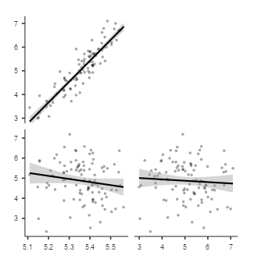
What does validity evidence look like?

Slide 4
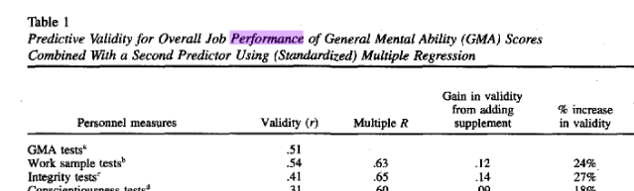
Schmidt & Hunter (1998)

Slide 5
Using Schmidt & Hunters (1998) findings
Candidate | GMA (T score) | Handwriting (T score)
1 | 50 | 50
2 | 40 | 75
3 | 60 | 30
4 | 50 | 70

Slide 6
DOPISDO (Dr Oliver’s Personality Inventory Scale Is for Demonstration Only’ )
Predictor
Dormaus (Sleepiness)
Openness to Criticism
Perfectionism
Inner-thinking
Sagacity
Outcome
Sleeping on the job
Lateness
Team work
Innovativeness
Messiness

Slide 7
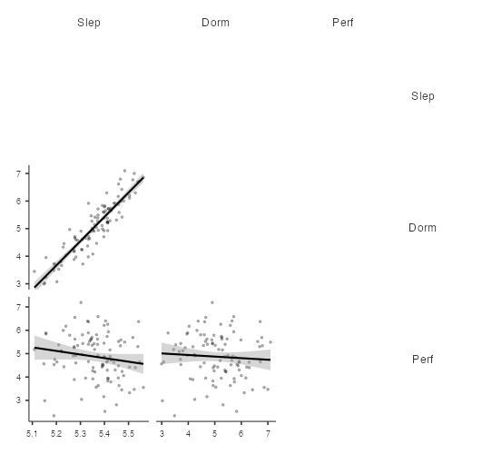
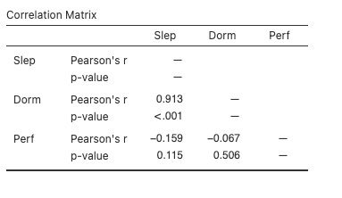
Predicting sleeping at work

Slide 8
Sleep on the Job?
Candidate | Dormaus | Perfectionism
1 | T = 20 | T = 70 | Unlikely to sleep on the job
2 | T = 60 | T = 30 | Likely to sleep on the job
3 | T = 50 | T = 50 | No more or less likely to sleep on the job

Slide 9
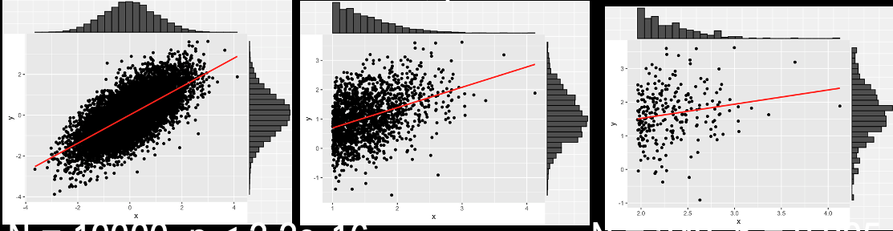
Points to Consider

